Slide 1


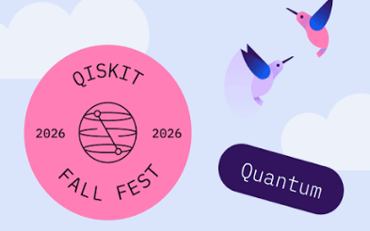



Interstate Hackathon Event Launch
Abhijit Chakraborty
Department of Physics and Astronomy, Middle Tennessee State University
Interstate quantum hackathon for beginners 2026
Scan me!

Slide 2
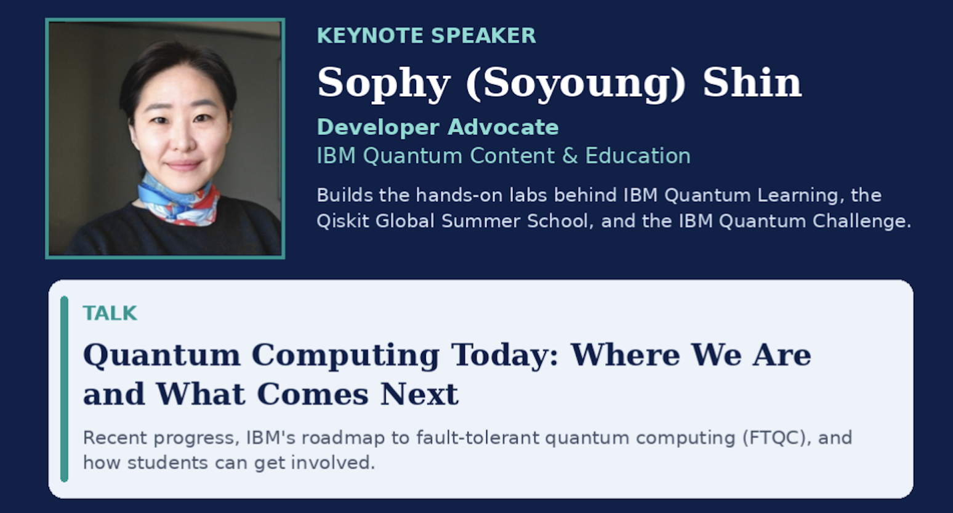
Schedule
Thursday, October 22, 2026, 5:00 – 6:30 pm CDT: Event Launch
Friday, October 23, 2026, 5:00 – 6:30 pm CDT: Industry Expert talk (by Sophy Shin, IBM Quantum). Discussion session
Saturday , October 24, 2026, 9:00 am – 4:00 pm CDT: Discussion, problem solving, coding, submission.
Closing ceremony: October 30 5:00 pm
Winners give a small presentation.
IQ Hack
MTSU
October 22, 2026
1

Slide 3
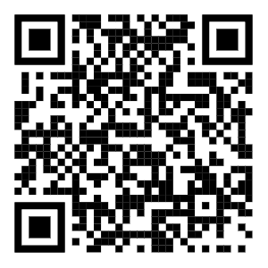
Hackathon Challenges
To review materials: Visit our GitHub repository
https://github.com/iq-hackathon/IQ-Hackathon-Fall-2026-Beginners
Three tracks:
  Variational Quantum Eigensolver (VQE)
  Quantum Machine Learning (QML)
  Quantum Approximate Optimization Algorithm (QAOA)
Github QR code
Challenge:
  Choose a track to work on.
  Take a look at the materials covered during the training session for the chosen track.
  Choose a problem related to the notebook.
IQ Hack
MTSU
October 22, 2026
2

Slide 4
Hackathon Challenges: Example problem
VQE:
    Hamiltonian for a different molecule/ different bond length: trying to find ground state.
    Effect of different circuit parametrization/optimizer.
    Gradient-based vs gradient-free optimization.
    Physics problem: many-body physics Hamiltonian (Ising model, Heisenberg model).
QML:
    Use different feature map.
    Use different dataset.
    Explore variational quantum classifier for a classification problem you like.
    Use different QML algorithm.
IQ Hack
MTSU
October 22, 2026
2

Slide 5
Hackathon Challenges: Example problem
QAOA
    Choose optimization problem to solve using a QUBO.
    Check effects of optimizers.
    System size effect.
    Different mixer Hamiltonian.
The goal is to explore as much as you can once you choose a topic. The more exploration you do the more you learn.
It will also enrich your submission, making you a better contender for the prize.
IQ Hack
MTSU
October 22, 2026
2

Slide 6
Winners
There are two categories for your Hackathon submission:
  Rising-star: For people with no/very basic prior experience to Quantum Mechanics.
  Champion: For people with some/more experience to Quantum Mechanics.
Choose which category you want to submit to. However, the final choice of the category is determined by the grading committee.
There will be two winners in each of the Rising-star and Champion categories.
Everyone participating in the Hackathon gets the IBM and MTSU Badge.
IQ Hack
MTSU
October 22, 2026
2

Slide 7
Submission rules
You will be judged on your code submission and project report.
    You must submit your code (notebook) and project report via a public GitHub repository.
    Code must be functional with a command in the beginning that will install all necessary packages.
    Example: %pip install numpy scipy matplotlib ipywidgets pylatexenc qiskit pyscf qiskit_nature
    3. Report must haves:
      Your group’s name and all group members’ names, affiliation, department, and career level.
      Submission category.
      A bullet point summary list of what you did.
      A description of what is your motivation to choose the track and the problem
      Brief workflow explaining your code.
      Results. This is the most important part. Carefully report your results with proper plots (axes labelled).
Once you are done, send me an email with the link of your public repository containing the notebook and report.
      Abhijit.Chakraborty@mtsu.edu
IQ Hack
MTSU
October 22, 2026
2

Slide 8
Questions?

